Slide 1
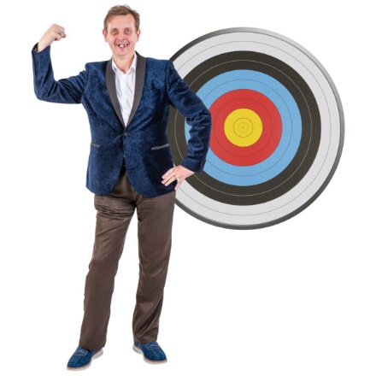
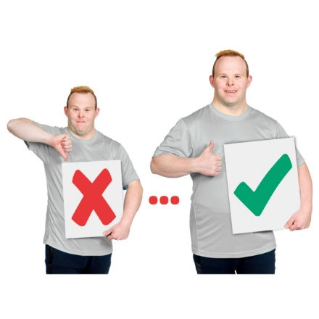
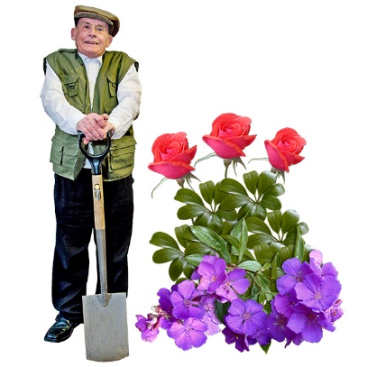
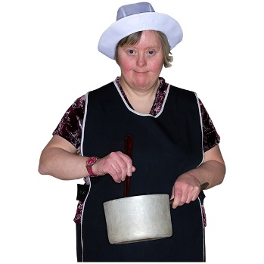
People We Support Awards Categories 2023
Awards Categories for Nominations
Outcome Achiever
Has someone you know been working on a specific goal that they have achieved this year?
Most Improved Skill
Has someone gotten better at using a specific skill?
Maybe their communication-talking, using Makaton or writing?
Great Gardener
Who is good at spending time in the garden?
Who is good with growing plants?
Master Chef
Who loves cooking? Who cooks food that is yummy to eat?
For example-who makes the best spaghetti bolognaise or bakes the best cake?

Slide 2
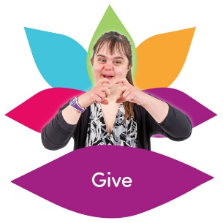
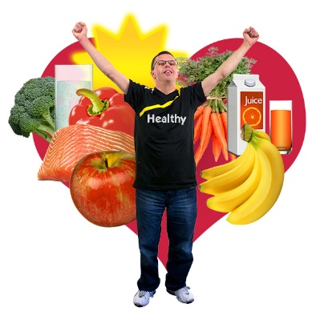
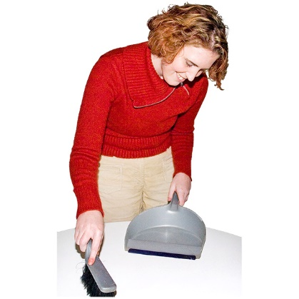
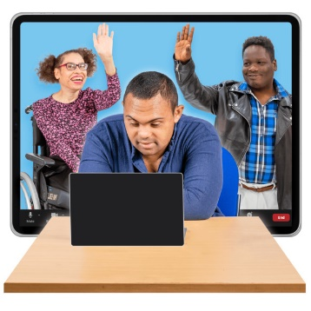
Volunteer Champion
Is someone involved with community activities?
Maybe they volunteer to help at a charity shop, or church, or in a garden.
Wellness Warrior
Who enjoys healthy food?
Who encourages others to be healthier?
Helpful Housemate
Is there someone within your household that goes above and beyond doing chores and keeping the place nice to live in?
Technology Wizard
Who is good at using phones or computers and shows a curiosity for how it all works?

Slide 3
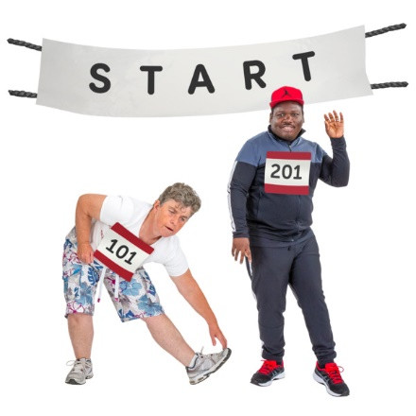
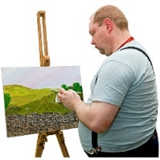
Sports Star
Do you know someone that loves sport?
Does someone encourage others to get active?
Awesome Artist
Who enjoys making things?
It could be
painting
writing
jewellery making
poetry
anything artistic
.

